Slide 1
Final Project Proposal - Customer Churn Analysis and Prediction
Xiaolan Li

Slide 2

Introduction
In this project, I’m going to explore the reason behind customer churn and predict who’s about to leave currently. This can help the company to maximize the customer experience for preventing customer attrition. Therefore, it can help companies reduce losses and even increase the number of customers to increase profits. Additionally, this can be applied in every company, with a high impact value.

Slide 3
Problems
1.Who is more likely to leave and what’s the confidence of that prediction?
2.What kind of services are more related to whether a customer leave?
3.Which services should we improve to avoid current customer leaving?

Slide 4
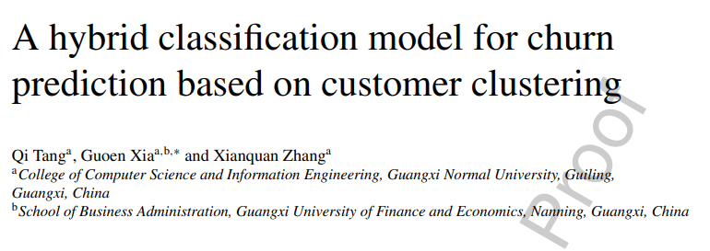
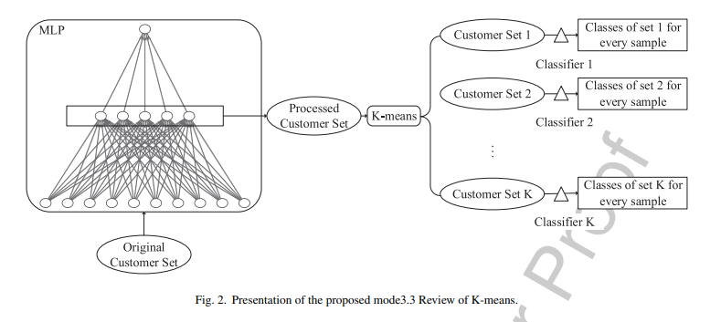
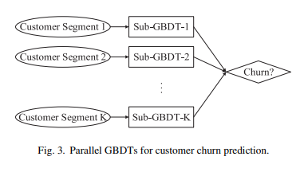
Related (prior) works
Clus GBDT
MLP>Kmeans>GBDT

Slide 5
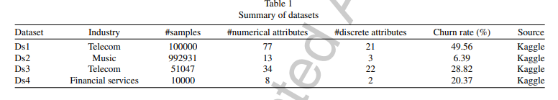
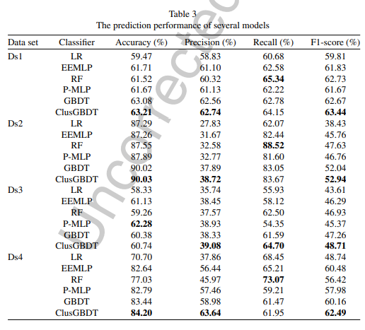
Related (prior) works

Slide 6
Possible outcomes
1.Finding out the best model to predict if a customer is going to leave.
2.Finding out the features that lead to a customer leave and do an order of them.
3.Finding out the most important reason lead to current customer leave.

Slide 7
Datasets
Downloaded from IBM community. Publish date May,2020.
(31 features, 7037 observations)
https://community.ibm.com/accelerators/?context=analytics&query=telco%20churn&type=Data
The data set is detailed in
https://community.ibm.com/community/user/businessanalytics/blogs/steven-macko/2019/07/11/telco-customer-churn-1113
The data set includes information about:
-- Customers who left within the last month – the column is called Churn
-- Services that each customer has signed up for – phone, multiple lines, internet, online security, online backup, device protection, tech support, and streaming TV and movies
-- Customer account information – how long they’ve been a customer, contract, payment method, paperless billing, monthly charges, and total charges
-- Demographic info about customers – gender, age range, and if they have partners and dependents

Slide 8
Learning Methods
Logistic Regression
KNN model
Random Forest
PCA
SVM

